Slide 1
Fen Reaper
April 29, 2016

Slide 2
Measurement across “Deep” - 21.5 inches

Slide 3
Deep – 21.5 inches

Slide 4
Width - 74 inches

Slide 5
Width - 74 inches

Slide 6
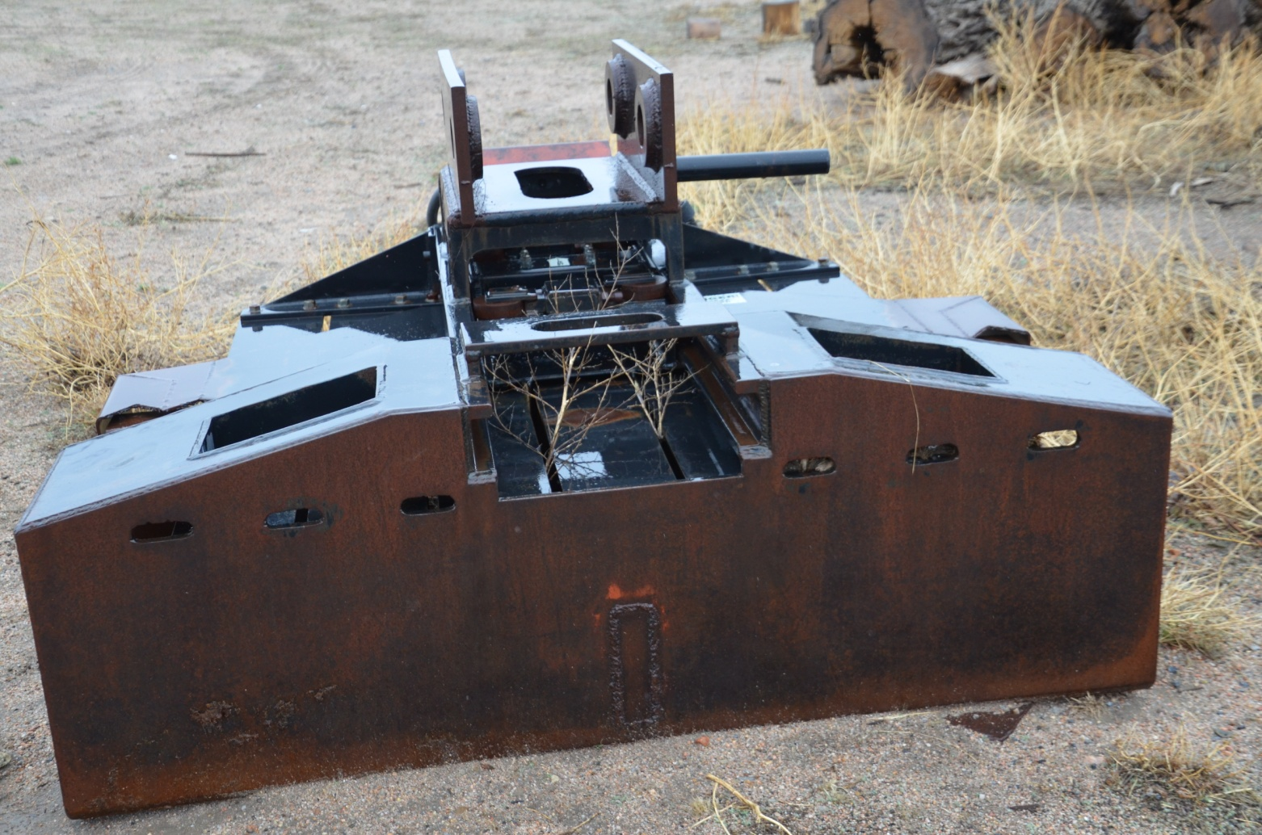
Front

Slide 7
Back

Slide 8
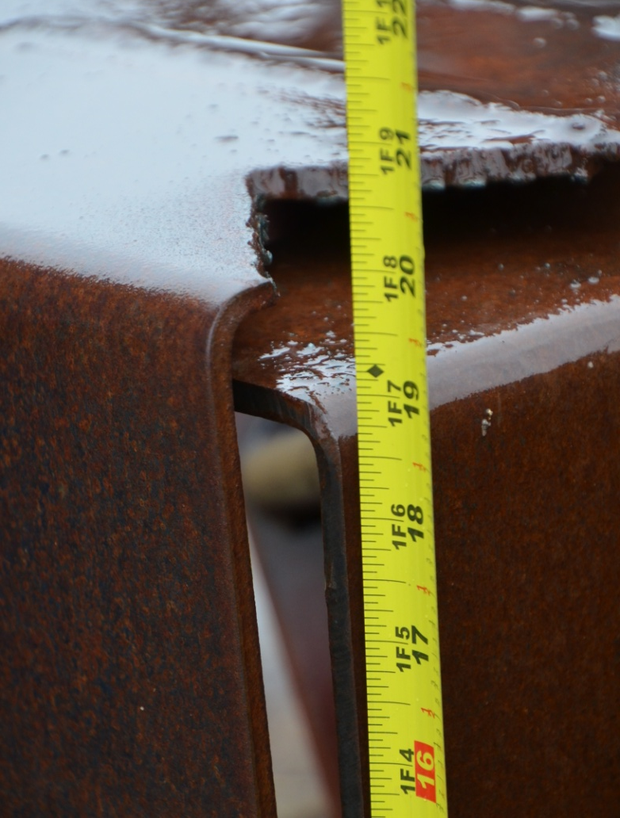
Tall - 18.5 inches

Slide 9
Pin size – 3 inches

Slide 10
Pin size – 3 inches

Slide 11
Inside measurement for pin – 12.25 inches

Slide 12
Inside measurement for pin – 12.25 inches

Slide 13
Outside measurements – 16.25 inches

Slide 14
Inside measurement for pin – 16.25 inches

Slide 15
Center to center on pin – 17.5 inches

Slide 16
Length of machine – 85 inches

Slide 17
Center to center on pin – 17.5 inches

Slide 18
Cutter plate

Slide 19
Cutter box

Slide 20
Bunny

Slide 21
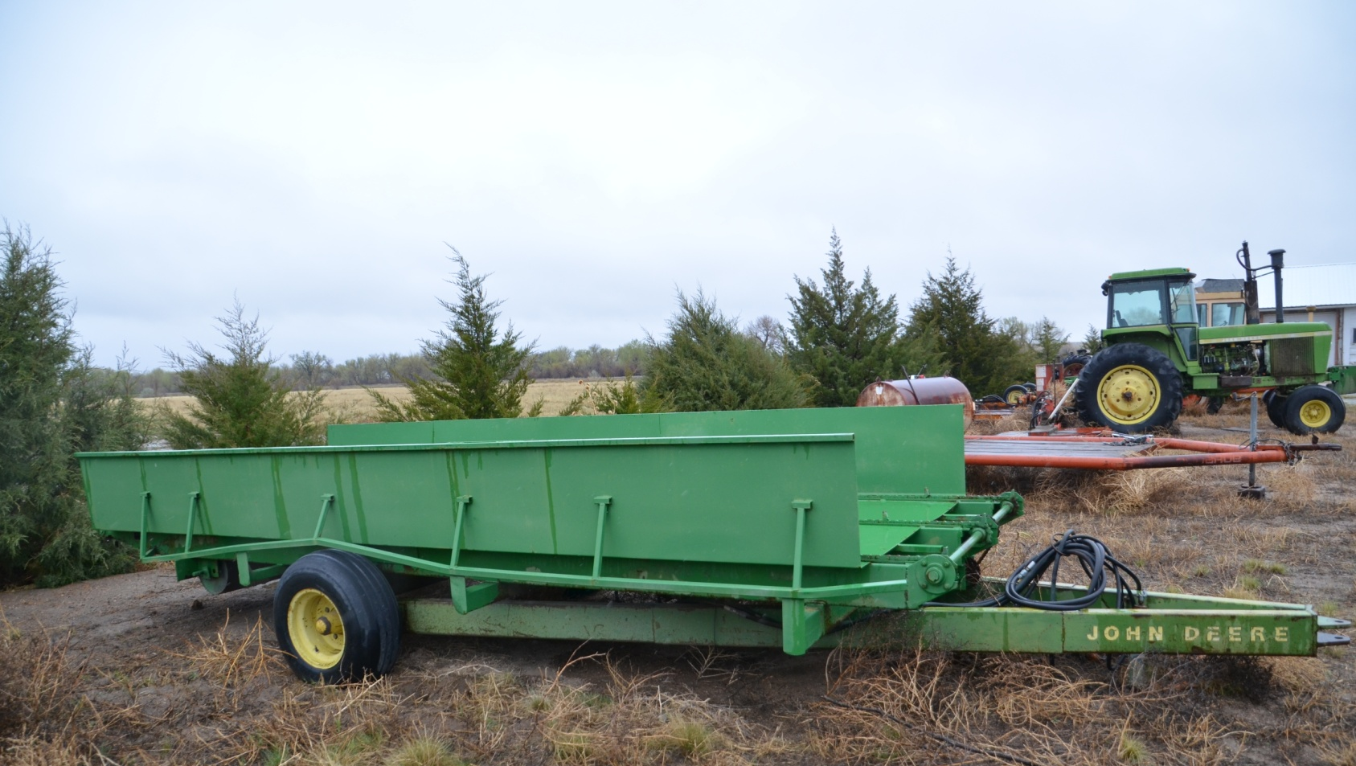
Size view of trailer

Slide 22
Trailer length - 16’ 8” inches

Slide 23
Front view of trailer

Slide 24
Back view of trailer

Slide 25
Width of trailer – 78 inches

